Slide 1
Selenium ToolKit
Web Application Testing – III

Slide 2
Selenium ToolKit
http://www.seleniumhq.org/
Selenium RC
(Obsolete)
Selenium IDE
Firefox Only
Run Tests in Parallel in different environments
Selenium
Selenium Grid
Multiple-Browsers
WebDriver
RemoteWebDriver
Execute Test cases in a remote machine

Slide 3
Selenium IDE Demo

Slide 4
Adding Assertions to the Script
Selenese allows multiple ways of checking for UI elements.
Verifications and assertions are used to check if
      an element is present somewhere on the page?
      specific text is somewhere on the page?
      specific text is at a specific location on the page?
Verifications and assertions are not one and the same.
If an assertion fails, the script will be aborted but if a verification fails the script will continue.

Slide 5
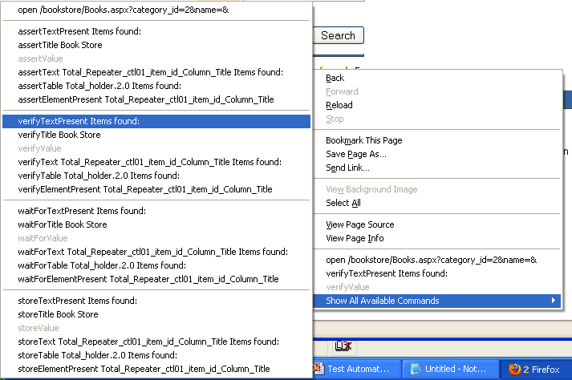
Verification Commands
verifyTextPresent
This command is used to check if a particular text is present in a page or not.
To add this command , While recording the test steps right click on the text item that you want verify. Once right clicked you can find an option “Show all commands”. On Clicking it you will find an option “verifyTextPresent”, select it

Slide 6
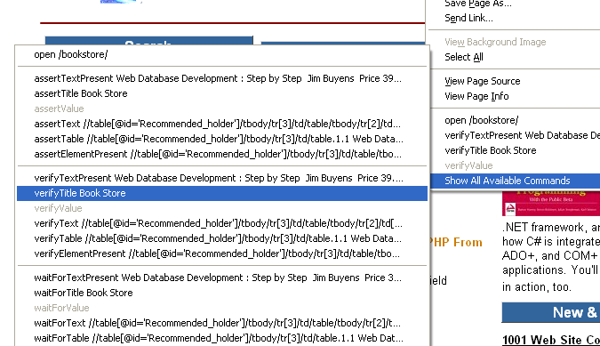
Verification Commands
verifyTitle
This command is used to check if the page title is correct or not.
To add this command , While recording the test steps right click any where on the page that you want verify. Once right clicked you can find an option “Show all commands”. On Clicking it you will find an option “verifyTitle”, select it

Slide 7
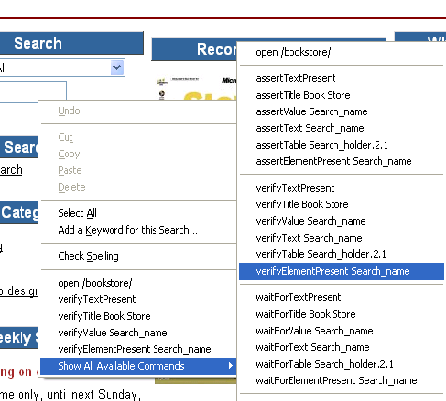
Verification Commands
verifyElementPresent
This command is used to verify if a page element is present in the page or not.
To add this command , While recording the test steps right click any element on the page that you want verify. Once right clicked you can find an option “Show all commands”. On Clicking it you will find an option “verifyElementPresent”, select it

Slide 8
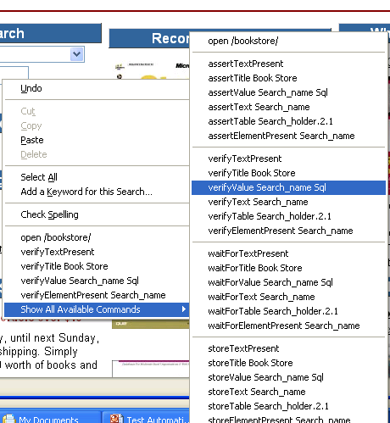
Verification Commands
verifyValue
This method is used to check if edit box has particular value or if the check box is on. Basically this method returns the value of present in the object.
To add this command , While recording the test steps right click any element on the page that you want verify the value of. Once right clicked you can find an option “Show all commands”. On Clicking it you will find an option “verifyValue”, select it.

Slide 9
Assertions
Assertions are same as Verifications. The only difference is, if the assertions fail the script will abort. But the script will continue run in case a verification point fails.
The steps for inserting the assertions is same as that of verification point.
While recording Right Click → Show all commands → select an assertion.

Slide 10
Assertion Statements
assertTextPresent
This will assert if the text is present in the page.
assertText
This will assert if a particular element is having the particular text.
assertTitle
This will assert if the page is having a proper title.
assertValue
    This will assert if a Text box or check box has a particular value
assertElementPresent
This will assert if a particular UI Element is present in the page.

Slide 11
Limitations of Selenium IDE
Can run the test only on Some browsers (Firefox, chrome)
No Programming login (like loops, conditional statements) can be applied
Selenium IDE can execute scripts created in Selenese only.
It is difficult to use Selenium IDE for checking complex test cases involving dynamic contents

Slide 12
Selenium WebDriver

Slide 13
Locating and Performing Operations on WebElements
By name
By.name()
By id
By.id()
By tagName
By.tagName()
By class name – this is with CSS
By.className()
By link text
By.linkText()
By partial link text
By.partialLinkText()
By xpath
By.xpath()
getAttribute
sendKeys
clear
submit
getLocation
getSize
…..
http://docs.seleniumhq.org/docs/03_webdriver.jsp

Slide 14
Selenium WebDriver Demo

